Slide 1
Video Game
Presentation WaterScapes
Color Sort Game

Slide 2
Team Members
Ahmed | Introduction, Audio Integration, Conclusion
Janees | Features
Sani | Levels
Sadia | Data Structure
Sheeraz | Graphical User Interface
Class: BSSE 3rd Morning ”A”
Teacher:
Ma’am Maryam Imtiaz

Slide 3
00
Introduction

Slide 4
Introduction
Waterscapes is an engaging color sorting game designed to test the player’s logic and strategic thinking. Players interact with a graphical interface to sort colors in tubes, ensuring each tube contains colors of a single type.

Slide 5
Table of contents
01
02
03
04
05
Features
Level
Data Structure
Audio Integration
Graphical User Interface

Slide 6
01
Features
Game Features

Slide 7
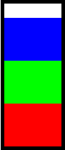
Core Gameplay Features
Color Sorting Mechanics:
Players pour colors between tubes to group them by type.
Only valid moves are allowed, such as pouring on matching colors or empty spaces.
Dynamic Scoring System:
Rewards valid moves and penalizes invalid ones.
Displays real-time score during gameplay.
PLAY

Slide 8
Controller
Select
Pour
Left Click to Select any Color
If Color is Same Then Pour into Tube
Invalid
Score
Invalid Attempt When you Pour Color in Wrong Tube
Score Maintain

Slide 9
02
Levels
How Level Design

Slide 10
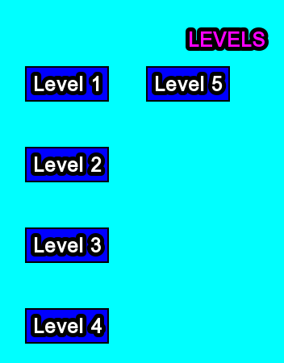
Levels
Multiple levels with increasing difficulty.
Tubes and colors are dynamically generated based on the level.
Intuitive level labeling and progression.

Slide 11
03
Data Structure
Data that we Use ine Our Game

Slide 12
Data Structure
Stacks
push(color): Adds a color to the stack if space permits.
pop(): Removes the top color from the stack.
peek(): Returns the top color without removing it.
isEmpty(): Checks if the stack is empty.
size(): Returns the number of colors in the stack.
getColor(index): Fetches the color at a specific index.

Slide 13
04
Graphical User Interface
GUI Libraray

Slide 14
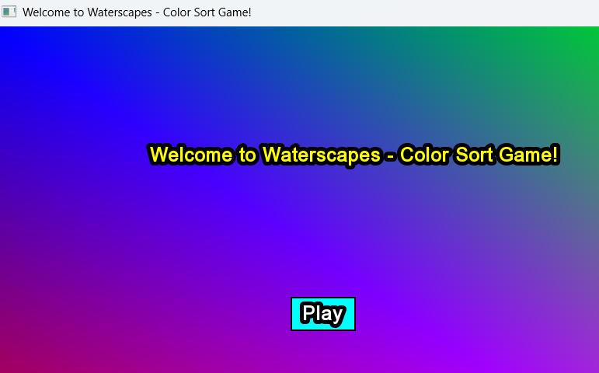
Graphical User Interface
Visually appealing tubes and colors.
Easy mouse interaction to select and pour colors.
Responsive design for smooth gameplay.

Slide 15
05
Audio Integration
Game Sound System

Slide 16
Audio Integration
Background music to enhance player experience.
Sound effects for interactions like pouring and invalid moves.

Slide 17

Conclusion
Waterscapes combines logical thinking with an interactive graphical interface to provide a fun and challenging gaming experience. The use of a stack-based data structure ensures efficient and realistic gameplay mechanics. With its dynamic levels, scoring, and visuals, Waterscapes is an enjoyable puzzle game for players of all ages

Slide 18

A picture is worth a thousand words
Thanks
Any Question

